Slide 1
The Effects of Ocean Currents on Climate Comparative Analysis of Seattle, WA and Ellsworth, MI GEOG 150 Physical Geography – Professor James McDougall Tracy Harvey June 9, 2024

Slide 2

Introduction
Welcome to this presentation on how ocean currents affect climate.
We'll explore the basics of ocean currents, their influence on global climates, and why places at similar latitudes can have vastly different weather patterns.
We'll focus on a comparative analysis of Seattle, WA, and Ellsworth, MI, to understand these effects in detail.
Notes:
- I grew up in Ellsworth Michigan.
- I have always found it odd that even though Seattle is at a higher latitude then my home it is far less severe in its climate
- lets explore why

Slide 3
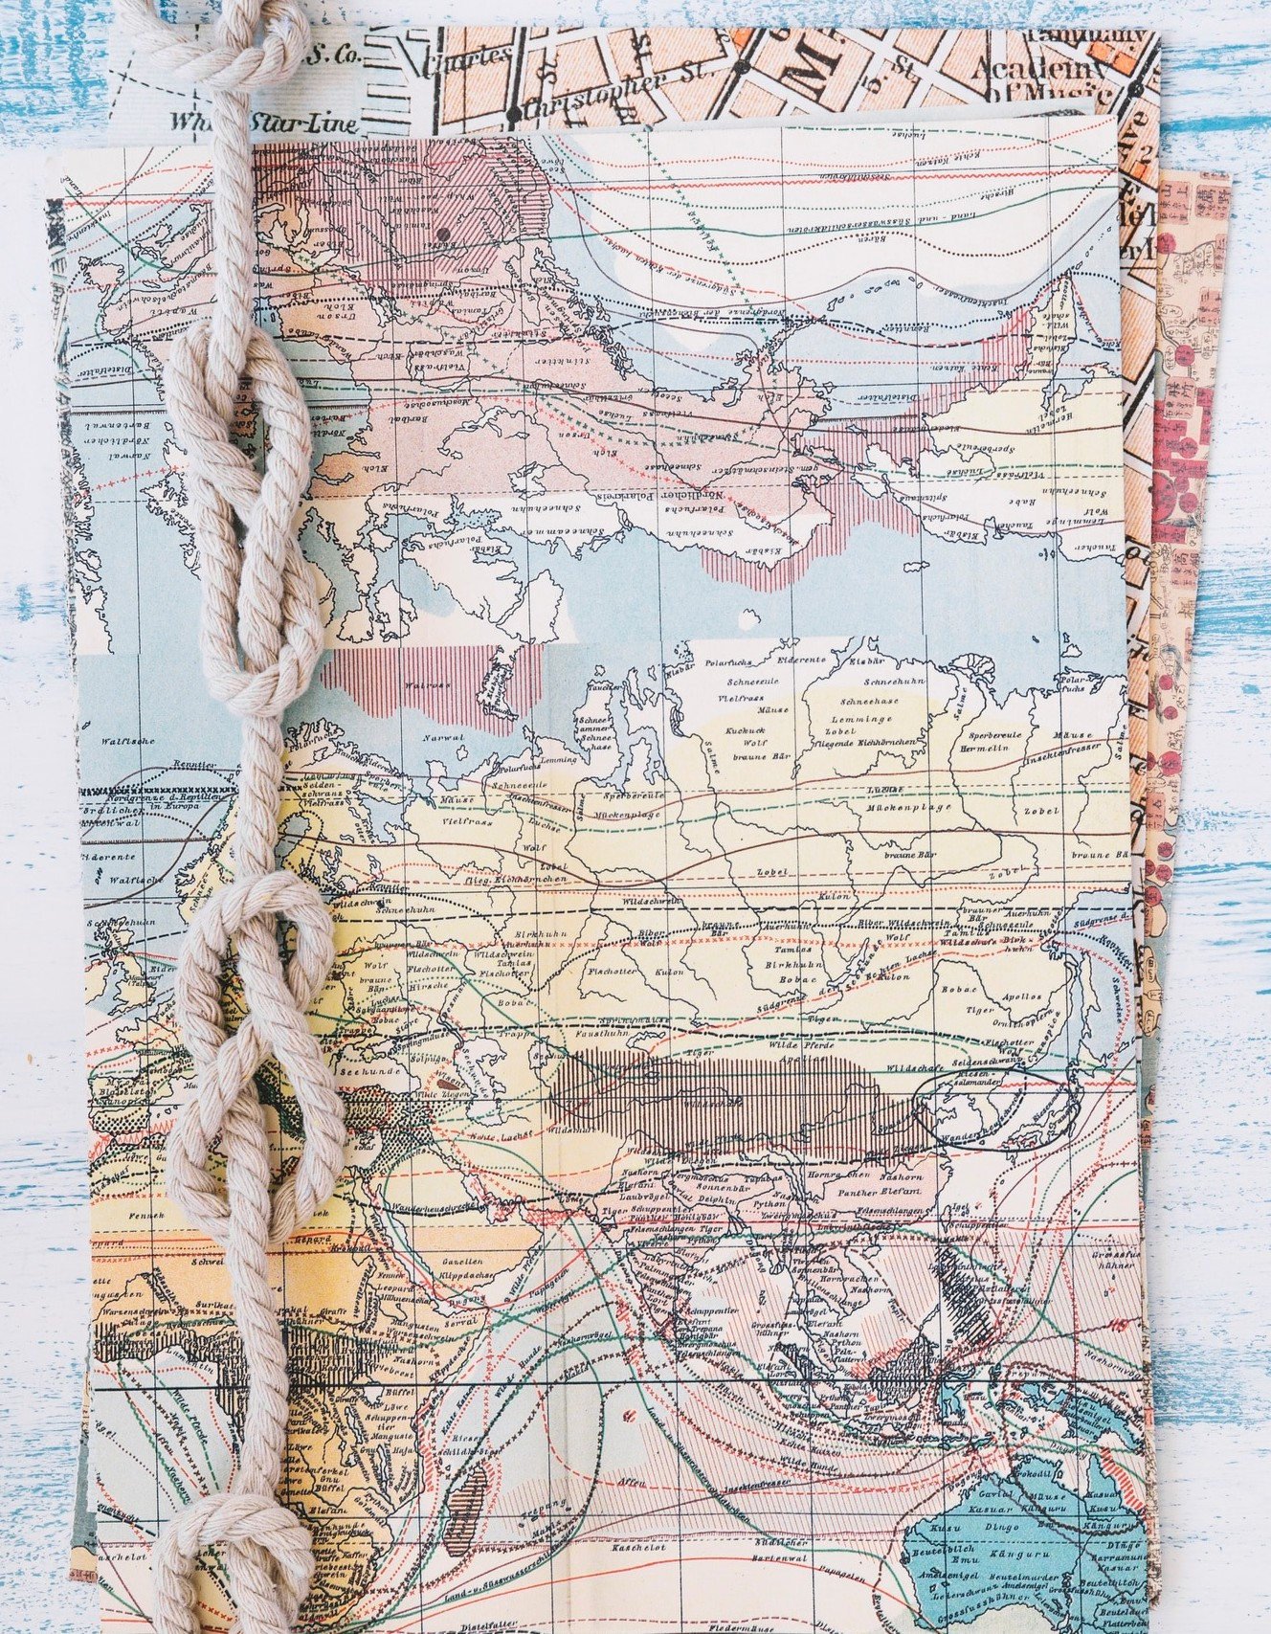
Understanding Ocean Currents
Ocean currents are continuous, directed movements of seawater generated by various forces.
They play a crucial role in regulating the Earth's climate by redistributing heat across the planet.
Major forces driving ocean currents include wind, the Coriolis effect, and differences in water density due to temperature and salinity.
Notes:
- The ocean and it’s currents are very much a cycling and filtration system
- much like your air conditioning system
- or air purifier

Slide 4
Types of Ocean Currents:
Surface Currents: Driven primarily by wind patterns and the rotation of the Earth. They affect the upper 400 meters of the ocean.
Deep-Water Currents: Also known as thermohaline circulation, these currents are driven by differences in water density, which is affected by temperature (thermal) and salinity (haline).
Both types work together to circulate water globally in a complex system known as the global conveyor belt.
Notes:
- This “conveyor belt” of currents does many things:
Distribute heat across the world, affecting climate and weather
Transport nutrients to marine ecosystems
Mixing of the ocean waters which is vital to maintaining the chemical balance in the oceans

Slide 5
Factors influencing Ocean Currents:
Wind: Trade winds, westerlies, and polar easterlies drive surface currents.
Coriolis Effect: The rotation of the Earth causes currents to deflect to the right in the Northern Hemisphere and to the left in the Southern Hemisphere.
Temperature and Salinity: Differences in water density, influenced by temperature and salinity, drive deep-water currents.
Topography: Ocean floor topography and coastlines can redirect currents.
Notes:
- The topography of the ocean floor can influence the direction of a current much like our surface topography can influence how the wind moves
Seamounts and ridges can act as barriers that redirect currents
Trenches can trap water which can affect the flow of deep ocean currents
Continental shelves can enhance or hinder the movement of water

Slide 6

How Ocean Currents Affect Climate
Ocean currents distribute heat from the equator toward the poles and cold water from the poles back to the tropics.
Warm currents can raise temperatures of nearby coastal regions, while cold currents can lower them.
They also affect precipitation patterns, influencing local weather and climate.
Examples include the Gulf Stream warming Western Europe and the California Current cooling the west coast of the US.
Notes:
- Read the slide

Slide 7

Comparative Analysis: Seattle vs. Ellsworth
Geographic Locations:
Seattle, WA, is located at approximately 47.6° N latitude.
Ellsworth, MI, is located at approximately 45.2° N latitude.
Despite Seattle being farther north, it experiences milder climates compared to Ellsworth.
We will explore the reasons behind this difference in the upcoming slides.
Notes:
- Read the slide

Slide 8
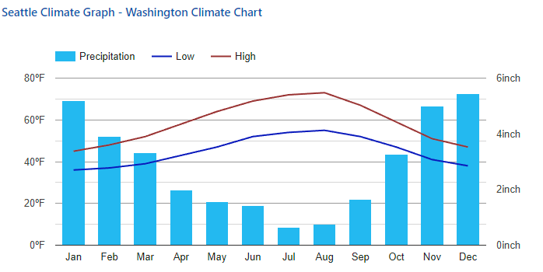

Climate of Seattle, WA
Seattle has a maritime climate, heavily influenced by the Pacific Ocean.
Winters are mild and wet, while summers are warm and dry.
Average January temperatures range from 36°F to 45°F, and average July temperatures range from 54°F to 72°F.
Annual precipitation is about 39 inches, mostly falling as rain in the winter months.
Notes:
- My first winter here I was very surprised by how not Michigan like the winter was.
- It was almost shorts weather back home
- The main thing that made it uncomfortable was that everything was constantly wet and then the wind gets you

Slide 9
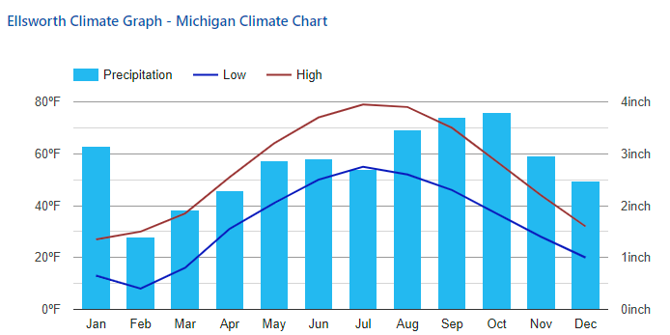

Ellsworth, MI Climate Analysis
Ellsworth experiences a continental climate, with significant seasonal temperature variations.
Winters are cold and snowy, while summers can be warm, rainy and humid.
Average January temperatures range from 13°F to 27°F, and average July temperatures range from 55°F to 79°F.
Annual precipitation is about 34 inches, with significant snowfall in winter.
Notes:
- Winters in Michigan can last from late October (I have been trick-or-treating in the snow) to early to mid may.
- The main thing with Michigan summers is the humidity because the state is surrounded by the great lakes which are constantly evaporating into the atmosphere
- I was kind of surprised when I learned that Michigan gets almost as much precipitation as Washington just in the form of snow in the winter

Slide 10
Ocean Current Influence on Seattle’s Climate
Seattle's climate is moderated by the North Pacific Current, which brings relatively warm water from the subtropics.
This current prevents extreme temperature fluctuations, resulting in milder winters and cooler summers.
The moist air from the Pacific also contributes to Seattle’s high levels of winter precipitation.
Notes:
- Read slide

Slide 11
Continental Influence on Ellsworth’s Climate:
Ellsworth’s climate is influenced by its inland location, far from the moderating effects of large water bodies.
Without the influence of warm ocean currents, Ellsworth experiences more extreme temperature variations.
Cold air masses from the Arctic and warm air masses from the Gulf of Mexico contribute to its harsher seasonal extremes.
Notes:
- In the winter we would get something called lake-effect snow which usually was in the form of gently falling “wet” snow but the flakes would be the size of your thumb

Slide 12
Seasonal Extremes Comparison:
Seattle, WA: Milder seasonal changes due to oceanic influence; smaller temperature range.
Ellsworth, MI: Larger temperature range due to continentality; more extreme winters and warmer summers.
Factors contributing to these differences include proximity to ocean currents and geographic location.
Notes:
- Read slide

Slide 13

Conclusion
Ocean currents play a critical role in regulating climate by redistributing heat around the planet.
Seattle, despite being at a higher latitude, enjoys a milder climate due to the influence of the North Pacific Current.
Ellsworth, influenced by continental factors and lack of oceanic moderation, experiences harsher seasonal extremes.
Understanding these dynamics helps us appreciate the complex interactions between ocean currents and climate.
Notes:
- For myself it was interesting to see how being in an area near the oceans can take what should be a severe climate and make it more suitable to human habitation

Slide 14

References:
Climate Ellsworth—Michigan and Weather averages Ellsworth. (n.d.). Retrieved June 11, 2024, from https://www.usclimatedata.com/climate/ellsworth/michigan/united-states/usmi1335
Climate Seattle—Washington and Weather averages Seattle. (n.d.). Retrieved June 11, 2024, from https://www.usclimatedata.com/climate/seattle/washington/united-states/uswa0395

